Slide 1
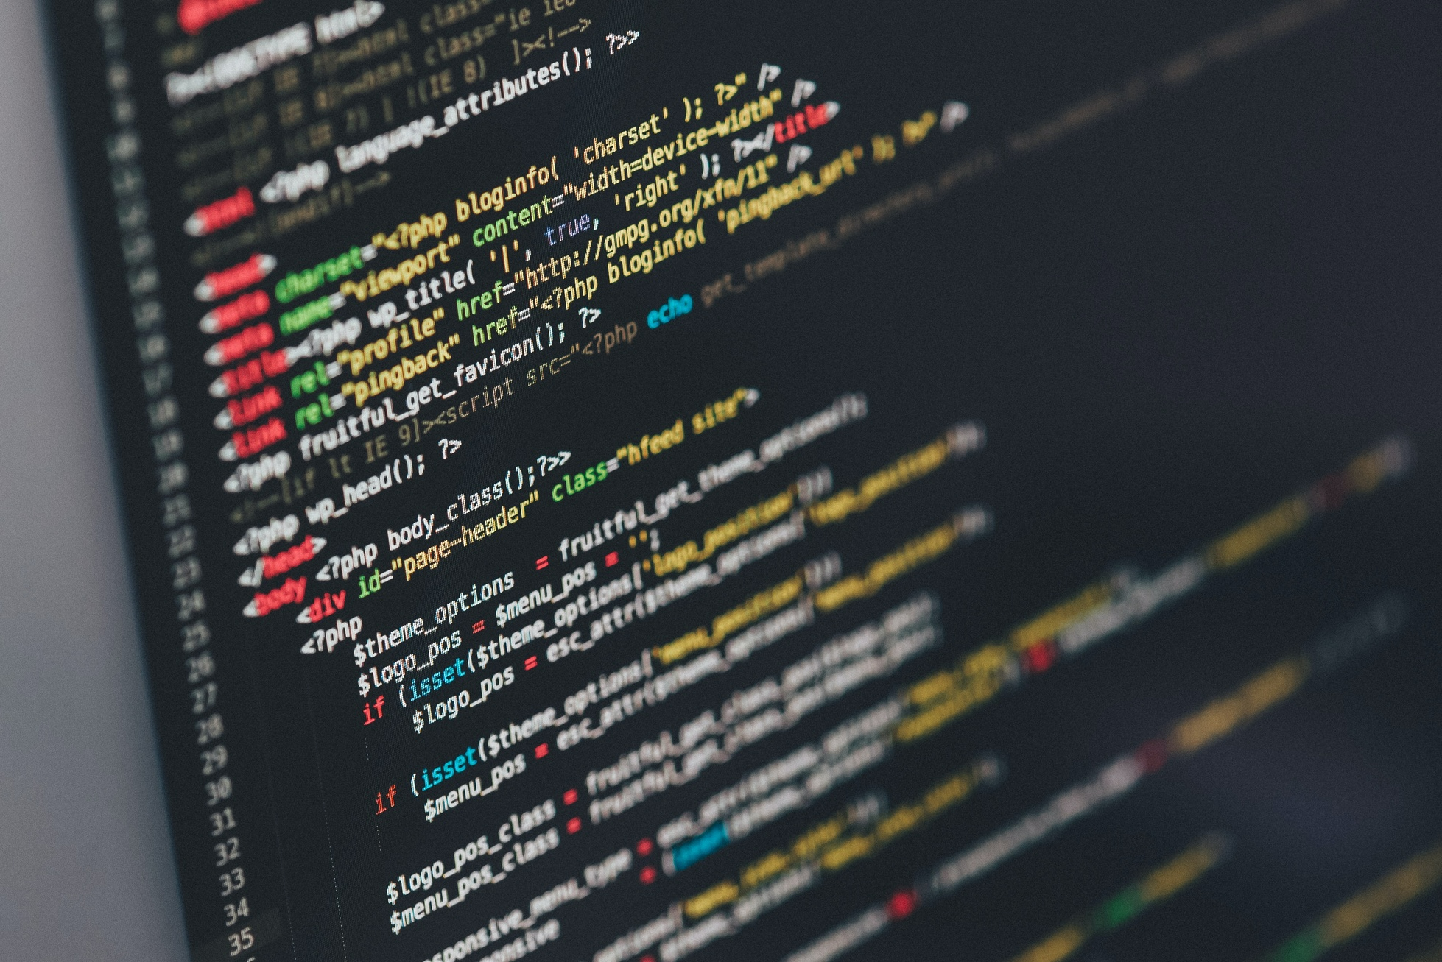

Passive voice
Passive voice in English
Importance in computer science academic writing
Notes:
Hello everyone! Today, we're going to talk about the passive voice in English and its importance in computer science academic writing. This is especially useful for those of you studying computer science and looking to improve your English writing skills.

Slide 2
Passive Voice Usage
Focus on process, results, and research
Examples:
Process: The software was updated to fix the bug.
Results: The test accuracy was improved by 10%.
Research: The model was trained using a large dataset.
Notes:
Now, let's discuss how and when to use the passive voice. In computer science writing, the passive voice is often used to focus on the process, results, or research rather than who did the work. This makes the writing more objective. Here are some examples: For a process: "The software was updated to fix the bug." For results: "The test accuracy was improved by 10%." For research: "The model was trained using a large dataset."

Slide 3
Limitations of Passive Voice
Not suitable for intransitive verbs
Examples of intransitive verbs: sleep, arrive, laugh
Notes:
However, it's essential to know that not all verbs can be used in the passive voice. Intransitive verbs, which are verbs that don't have an object, cannot be made passive. This is because there's no object to move to the subject position in the sentence. Here are some examples of intransitive verbs: sleep, arrive, and laugh. Remember, only transitive verbs, those with an object, can be used in the passive voice.

Slide 4
Summary
Passive voice emphasizes action, not the doer
Useful for objective and clear writing in computer science
Use with transitive verbs only
Notes:
In conclusion, the passive voice is an important tool for writing clear and objective sentences in computer science academic writing. It allows you to emphasize the action, not the doer, and helps keep the focus on the ideas. However, keep in mind that you should use the passive voice only with transitive verbs. Good luck with your writing, and I hope this information helps you create better academic papers!

